Slide 1
Checking understanding of ordering and comparing numbers
Place value

Slide 2
how to use Oak lessons

Slide 3
I can order and compare numbers and measures using < , >, =

Slide 4
A digit is one of the symbols of a number system. In our number system we use the digits 0, 1, 2, 3, 4, 5, 6, 7, 8 and 9.
An integer is any positive or negative whole number or zero. E.g. -2, 0, 153 are all examples of integers.

Slide 5

Checking understanding of ordering and comparing numbers
Reviewing the use of < , > and =
Comparing numbers using ≤ and ≥

Slide 6
Reviewing the use of < , > and =
The symbol < means “less than”.
The value on the left is less than the value on the right.
4.07 < 4.7

Slide 7
Reviewing the use of < , > and =
The symbol < means “less than”.
4.07 < 4.7

Slide 8
Reviewing the use of < , > and =
The symbol > means “greater than”.
The value on the left is greater than the value on the right.
0.13 > 0.098

Slide 9
Reviewing the use of < , > and =
The symbol > means “greater than”.
0.13 > 0.098

Slide 10
Reviewing the use of < , > and =
The symbol = means “equal to”.
The value on the left is equal to the value on the right.
two thousand = twenty hundreds

Slide 11
Reviewing the use of < , > and =
The symbol = means “equal to”.
two thousand = twenty hundreds

Slide 12
Reviewing the use of < , > and =
The value on the left the value on the right.
4
12

Slide 13
Reviewing the use of < , > and =
The value on the left is less than the value on the right.
4
<
12

Slide 14
Reviewing the use of < , > and =
The value on the left the value on the right.
Four tens
40

Slide 15
Reviewing the use of < , > and =
The value on the left is equal to the value on the right.
Four tens
=
40

Slide 16
Reviewing the use of < , > and =
The value on the left the value on the right.
0.6
0.06

Slide 17
Reviewing the use of < , > and =
The value on the left is greater than the value on the right.
0.6
<
0.06

Slide 18
Reviewing the use of < , > and =
Compare these two numbers and write a statement showing which is greater.
0.4 million
40 000

Slide 19











Reviewing the use of < , > and =
Compare these two numbers and write a statement showing which is greater.
0.4 million
HMn | TMn | Mn | HTh | TTh | Th | H | T | O | T | H | Th | TTh
th
th
th
th
0
4
0
0
0
0
0
4 0 0 0 0
40 000
0.4 million
40 000

Slide 20
Reviewing the use of < , > and =
Compare these two numbers and write a statement showing which is greater.
8.04781009
8.047809

Slide 21
Reviewing the use of < , > and =
Compare these two numbers and write a statement showing which is greater.
8 0 4 7 8 1 0 0 9
8.04781009
8 0 4 7 8 0 9
8.04781009 > 8.047809
8.047809
or
8.047809 < 8.04781009

Slide 22

Reviewing the use of < , > and =
Which of the following mathematical sentences are correct?
Change the symbol to correct the others.
50.425 < 50.453
four point three two > 4.032
four point three two = 4.032
43 hundreds = four thousand three hundred
47 thousandths = 4.7 hundredths
47 thousandths < 4.7 hundredths

Slide 23
Reviewing the use of < , > and =
In each set of numbers, which is the bigger value?
Write a statement using <, > or = to compare the values.
9 9.00
1900
fourteen thousand
9.5 million
9 350 647
1.09 1.4
109 000 140 000
0.4 0.09
0.04 0.019
190 000 1.4 million
19.04 19.104
Write your own comparison statements using the digits 0, 1, 4 and 9. Try to write a statement no one else has thought of.

Slide 24
Reviewing the use of < , > and =
In each set of numbers, which is the bigger value?
9 = 9.00
1900 <
fourteen thousand
9.5 million
9 350 647 <
1.09 < 1.4
109 000 < 140 000
0.4 > 0.09
0.04 > 0.019
190 000 < 1.4 million
19.04 < 19.104
Write your own comparison statements using the digits 0, 1, 4 and 9. Try to write a statement no one else has thought of.
E.g. 0.0419 < 0.1049 9104 thousand > 9.09 million 10.4 hundredths = 0.104

Slide 25
Checking understanding of ordering and comparing numbers
Reviewing the use of < , > and =
Comparing numbers using ≤ and ≥

Slide 26




Comparing numbers using ≤ and ≥
What does this sign mean?
That the speed limit is 30 miles per hour.
30
The speed of the vehicles must be less than or equal to 30.
Andeep
The maximum speed is 30.
Sam
Jacob

Slide 27
Comparing numbers using ≤ and ≥
What does this sign mean?
30
speed ≤ 30 mph

Slide 28

Comparing numbers using ≤ and ≥
Which speeds from the right can go in the box?
speed
30.001 mph
21.09 mph
29.999 mph
21.09 mph
29.999 mph
0.67 mph
≤ 30 mph
0.67 mph
32 mph
30 mph
30 mph
1.02 mph
37 mph
97 mph
1.02 mph

Slide 29
Comparing numbers using ≤ and ≥
Which of the following numbers could go in the box?
≤ 30
27.9
30
34

Slide 30
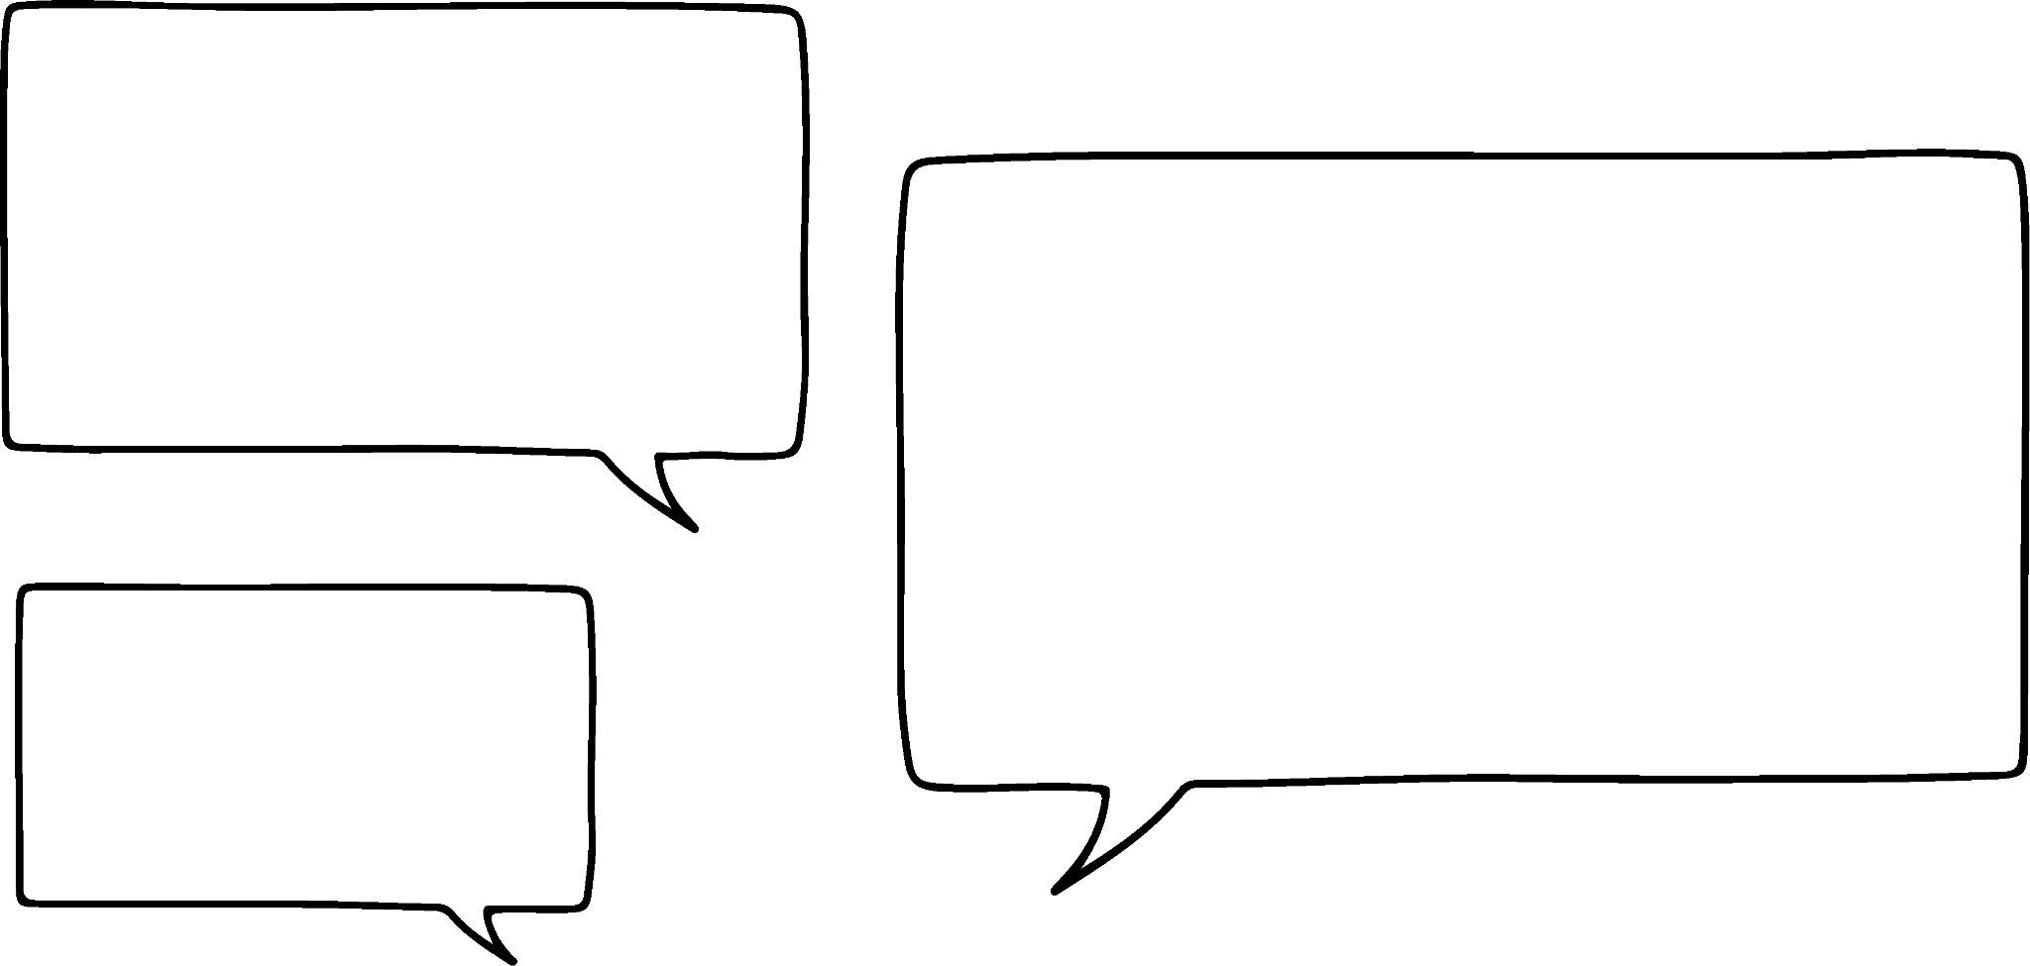

Comparing numbers using ≤ and ≥
Why not just use
“speed < 31” then we don’t need the new symbols?
30
Can you find an example to help change Jun’s mind? What argument could you use to persuade him?
Any number between 30 and 31 works as a counter example.
E.g. 30.5, 30.403, 30.927, etc. would be above the speed limit but still less than 31.
Jun would be right if all the numbers had to be integers, but that isn’t always true so these new symbols are really helpful!

Slide 31
Comparing numbers using ≤ and ≥
For each statement below write the number sentence using < , > , ≤ , ≥ or = . Which of the numbers fit the statement?
It takes me at least 12 minutes to walk to school.
Time to walk to school
12 minutes
21
12
11.5
A hummingbird’s wings beat more than four thousand times a minute.
Wing beats per minute
Four thousand
4000
3099
4010
The maximum capacity at Wembley stadium is 90 000.
Number of people in stadium
90 000
9
90 000
90 001

Slide 32
Comparing numbers using ≤ and ≥
For each statement below write the number sentence using < , > , ≤ , ≥ or = . Which of the numbers fit the statement?
It takes me at least 12 minutes to walk to school.
Time to walk to school
12 minutes
21
12
11.5
≥
A hummingbird’s wings beat more than four thousand times a minute.
Wing beats per minute
Four thousand
4000
3099
4010
>
The maximum capacity at Wembley stadium is 90 000.
Number of people in stadium
90 000
9
90 000
90 001
≤

Slide 33

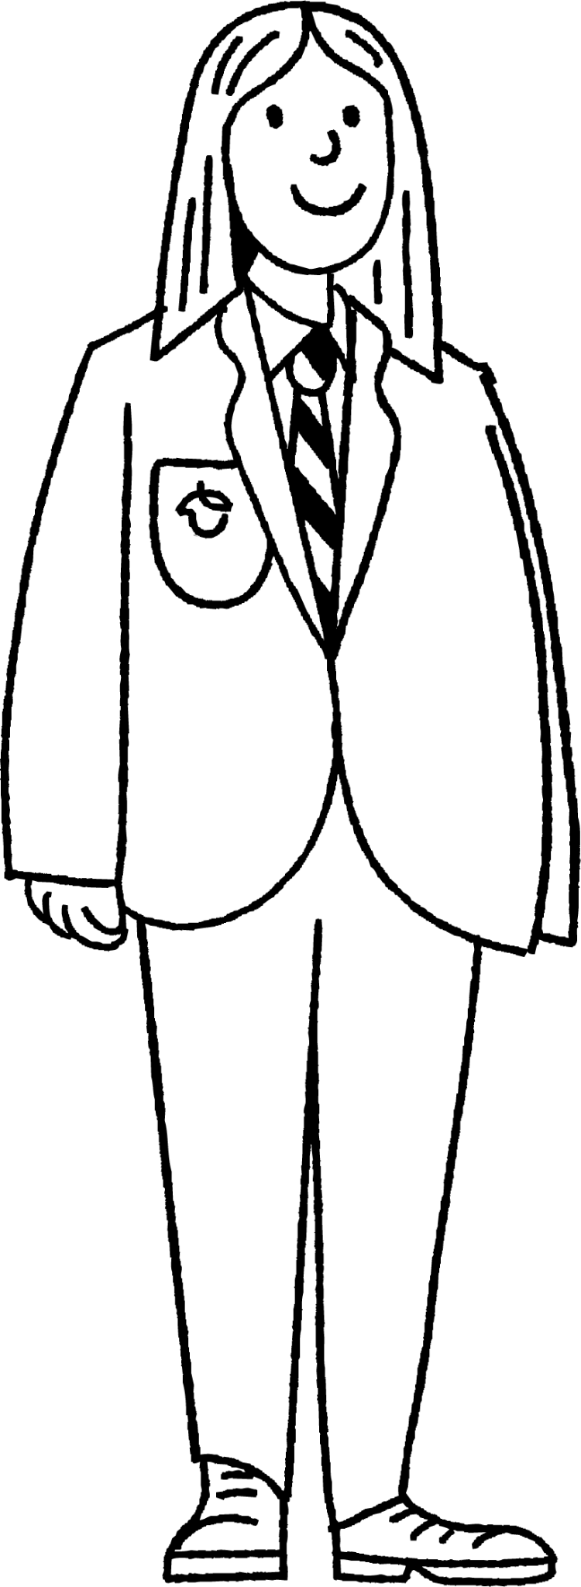
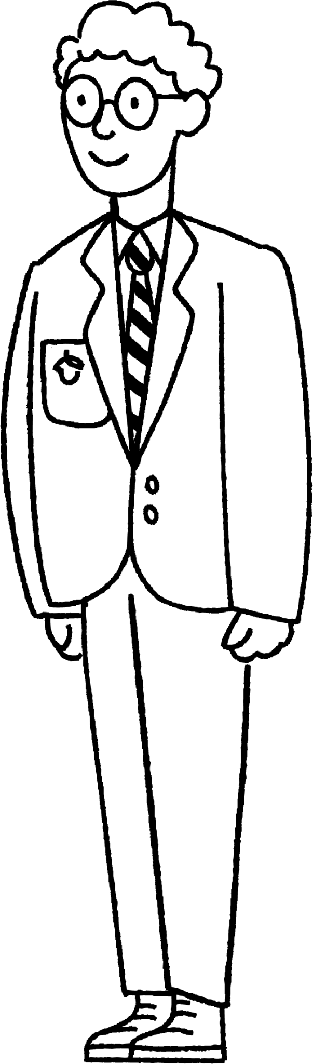
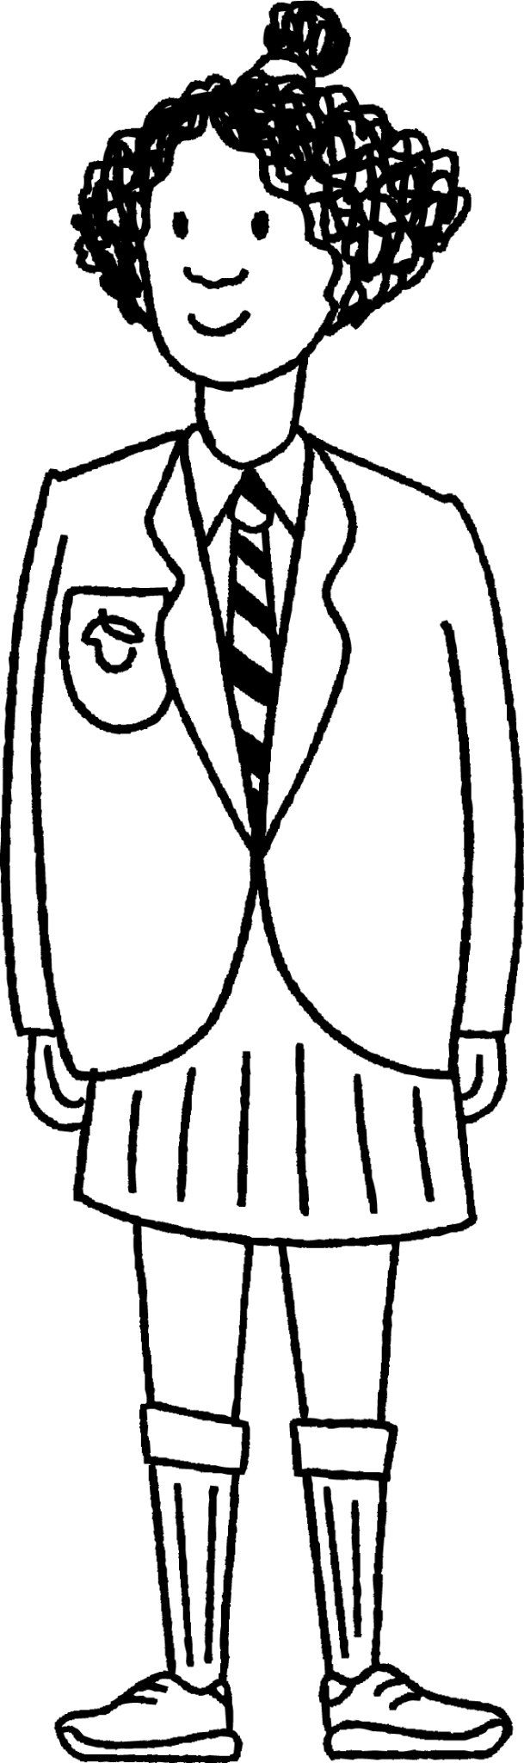
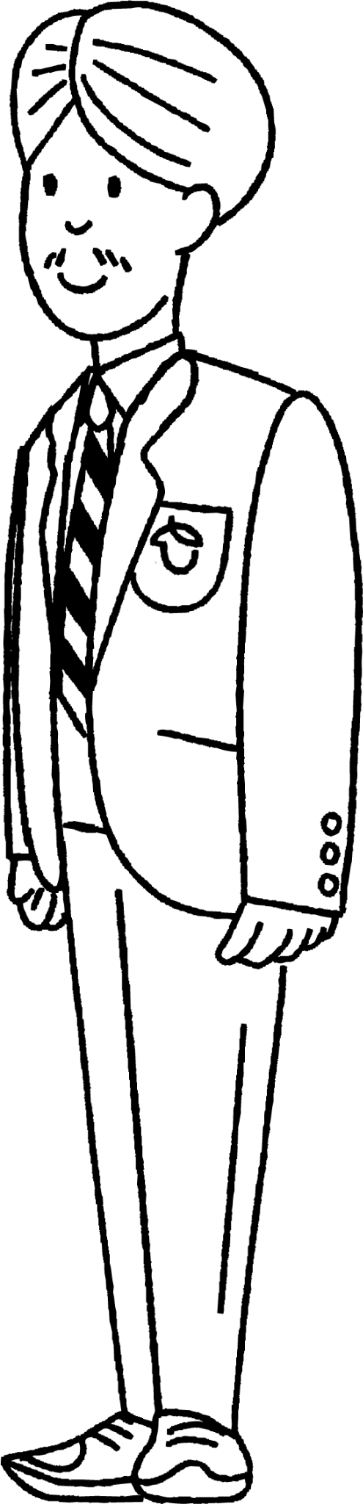
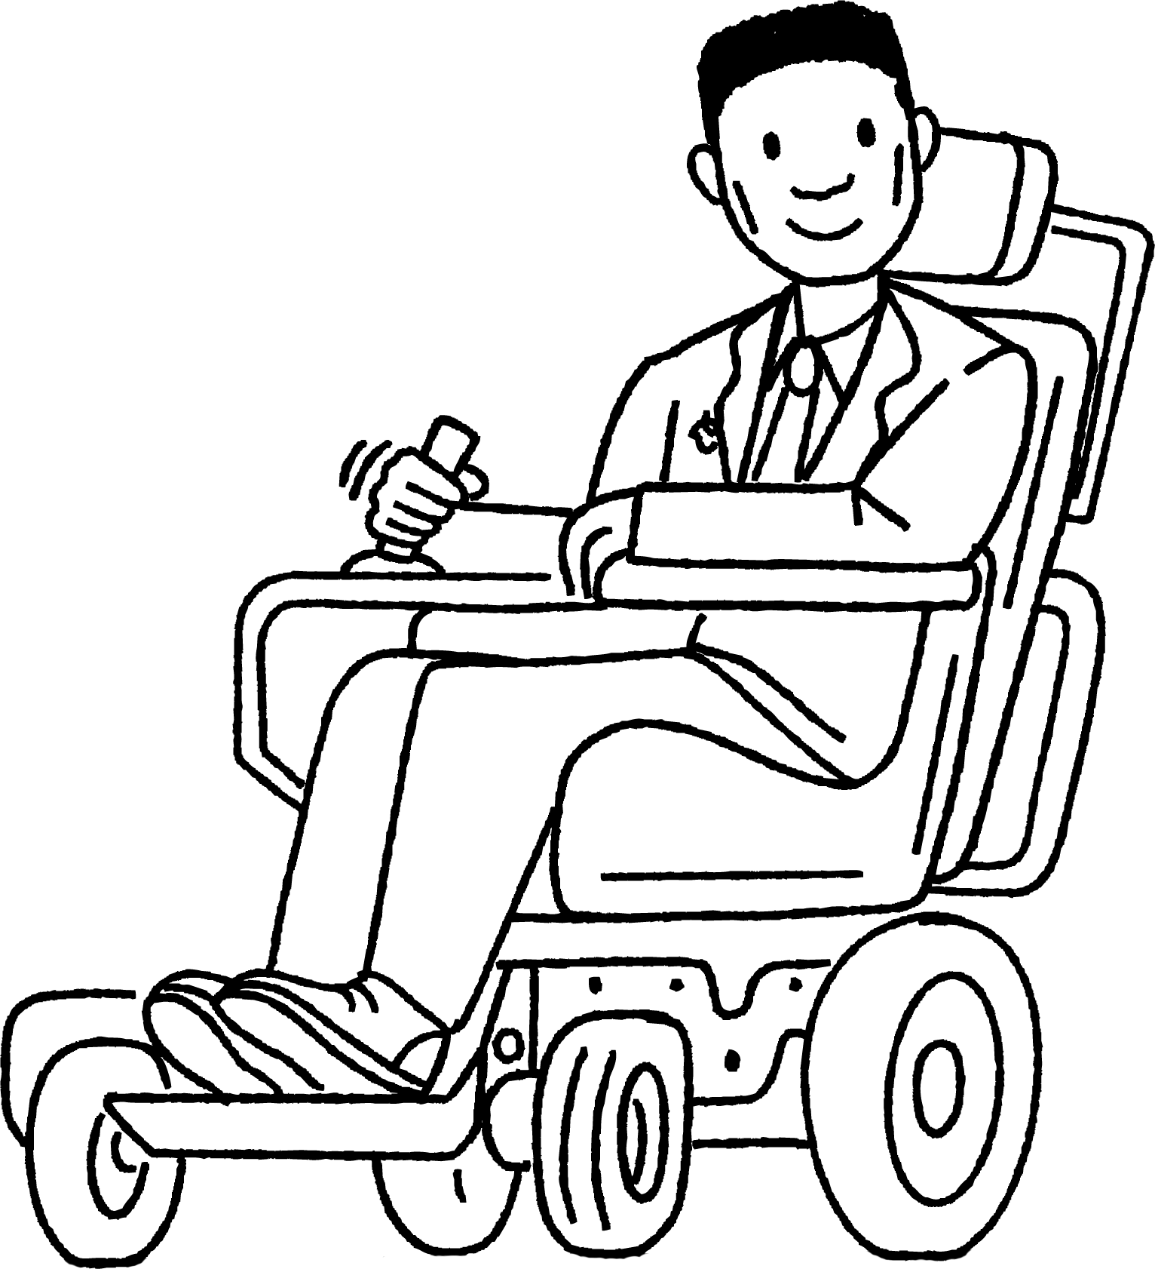
Comparing numbers using ≤ and ≥
Laura invites her friends out for her birthday. At the theme park, you get half price entry if you are under 1.5 m tall.
1) Complete the mathematical statement to describe the situation:
2) Who will get half price entry?
height
1.5 m
Laura 1.54 m
Age 12
Alex
1.53 m
Age 11.5
Sofia 1.44 m Age 11.75
Andeep 1.49 m
Age 11
Izzy
1.45 m Age 11.5
Lucas
1.5 m
Age 11.25

Slide 34
Comparing numbers using ≤ and ≥
Laura invites her friends out for her birthday. Laura wants to ride a big roller coaster. It says you have to be at least 1.45 m tall to ride it.
3) Write a mathematical statement to describe this.
4) Who can ride on the roller coaster?
Laura 1.54 m
Age 12
Alex
1.53 m
Age 11.5
Sofia 1.44 m Age 11.75
Andeep 1.49 m
Age 11
Izzy
1.45 m Age 11.5
Lucas
1.5 m
Age 11.25

Slide 35
Comparing numbers using ≤ and ≥
Laura invites her friends out for her birthday. After visiting the theme park, Laura is going to the cinema to watch a film that has a rating of 12.
5) Write a mathematical statement to describe this.
6) Is Laura’s choice of film a good one if she wants her friends to come along? Can you justify your answer?
Laura 1.54 m
Age 12
Alex
1.53 m
Age 11.5
Sofia 1.44 m Age 11.75
Andeep 1.49 m
Age 11
Izzy
1.45 m Age 11.5
Lucas
1.5 m
Age 11.25

Slide 36
Comparing numbers using ≤ and ≥
Laura invites her friends out for her birthday. At the theme park, you get half price entry if you are under 1.5 m tall.
1) Complete the mathematical statement to describe the situation:
2) Who will get half price entry?
height
<
1.5 m
Sofia, Andeep and Izzy will get half price entry.
Laura 1.54 m
Age 12
Alex
1.53 m
Age 11.5
Sofia 1.44 m Age 11.75
Andeep 1.49 m
Age 11
Izzy
1.45 m Age 11.5
Lucas
1.5 m
Age 11.25

Slide 37
Comparing numbers using ≤ and ≥
Laura invites her friends out for her birthday. Laura wants to ride a big roller coaster. It says you have to be at least 1.45 m tall to ride it.
3) Write a mathematical statement to describe this.
4) Who can ride on the roller coaster?
height
≥
1.45 m
Laura, Lucas, Andeep, Alex and Izzy can ride the big roller coaster.
Laura 1.54 m
Age 12
Alex
1.53 m
Age 11.5
Sofia 1.44 m Age 11.75
Andeep 1.49 m
Age 11
Izzy
1.45 m Age 11.5
Lucas
1.5 m
Age 11.25

Slide 38
Comparing numbers using ≤ and ≥
Laura invites her friends out for her birthday. After visiting the theme park, Laura is going to the cinema to watch a film that has a rating of 12.
5) Write a mathematical statement to describe this.
age ≥ 12
6) Is Laura’s choice of film a good one if she wants her friends to come along? Can you justify your answer?
Laura is the only person who is old enough to watch the film so perhaps she should choose a different film if she wants to watch with her friends.
Laura 1.54 m
Age 12
Alex
1.53 m
Age 11.5
Sofia 1.44 m Age 11.75
Andeep 1.49 m
Age 11
Izzy
1.45 m Age 11.5
Lucas
1.5 m
Age 11.25

Slide 39
Checking understanding of ordering and comparing numbers
The symbol < means less than.
The symbol > means greater than.
The symbol ≤ means less than or equal to.
The symbol ≥ means greater than or equal to.
Place value is important to be able to compare numbers.

Slide 40

© Oak National Academy 2023.
Produced in partnership with Mathematics in Education and Industry.
Licensed on the Open Government Licence v3.0, except where otherwise stated. See Oak terms and conditions.

